Slide 1
Unit 09
Database Applications

Slide 2
Agenda
What is a Database Application?
What are the common characteristics of a DB Application and how are they built?
An understanding of the layers of a Application (DB Application)
Exploration of the many application architectures of today
Database Application Development

Slide 3
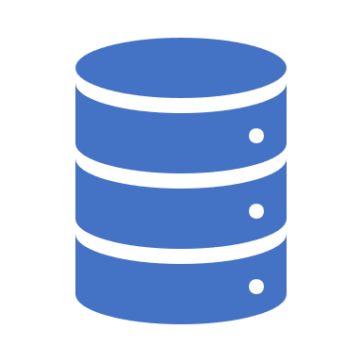
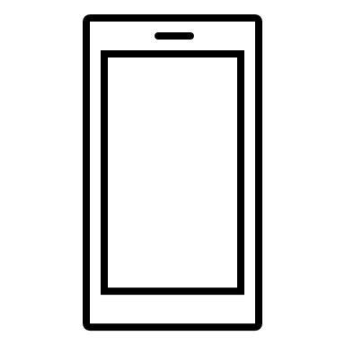
Database Applications

Slide 4
What is a Database Application?
Application which stores its data in a database management system
Application is data focused and its design is based on its data requirements.
Implementation is a data model-first approach.
Provides user interface for the CRUD Operations
Support for users and roles
Screens and reports

Slide 5
Db Application Facilitates Data Management
Database
Database Application Does Data Management
Meta-Data
Data “In”
Data
Information “Out”
End-User

Slide 6

Database Applications Have Many Names:
Database Application
Line of Business (LOB) Apps
Forms Over Data Apps
Model-Driven / Model-First Apps

Slide 7
Database Application Development Software
Software designed for the purpose of building database applications
Not a DBMS, but might have one built in.
No Code / Low Code development platforms
Examples:
Oracle APEX, Microsoft PowerApps, Google AppSheet, Amazon Honeycode,
Examples with a DBMS built in
Microsoft Access, Claris FileMaker Pro, Intuit QuickBase
Also called Rapid Application Development (RAD) Platforms/Tools

Slide 8

Check Yourself: Database Applications
Database Applications Provide a user interface to data management for end users.
True
False
Notes:
True

Slide 9
Check Yourself: Database Applications
Software used to create database applications will typically only work with a single DBMS.
True
False
Notes:
False – some work with a single DBMS but most are DBMS independent.

Slide 10

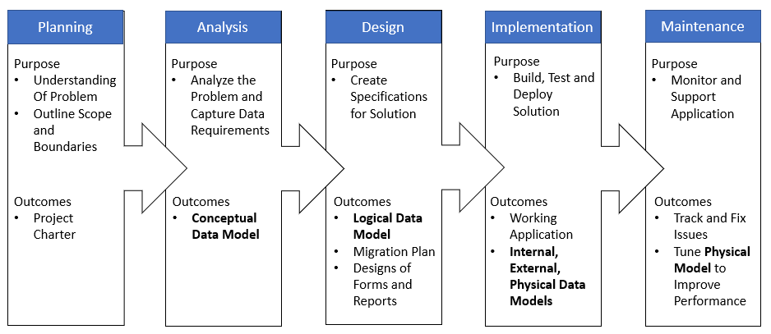
Recall: DBLC
Notes:
The database development lifecycle is a framework for building a database application. It starts with feasibility and ends with the maintenance of the completed application.

Slide 11
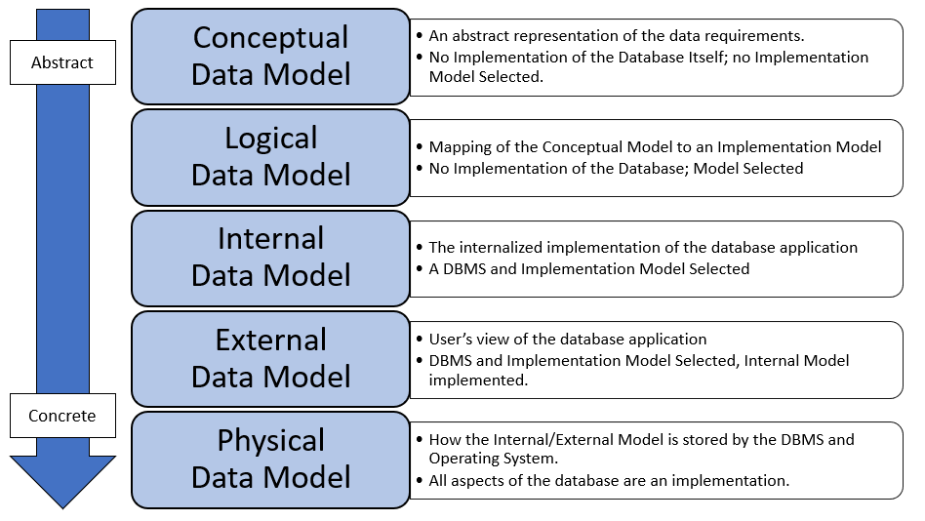
Recall: Data Models
Notes:
For any database there are 5 different representations of it, depending on the level of abstraction.

Slide 12

Database Applications Layers

Slide 13
Layers of a Modern Data-Oriented Application
Presentation
Code and layout responsible for the user interface
Business Logic
Data Logic
Data Management (CRUD) operations
Database
Transformational logic at the heart of what the application does
Data storage and retrieval

Slide 14
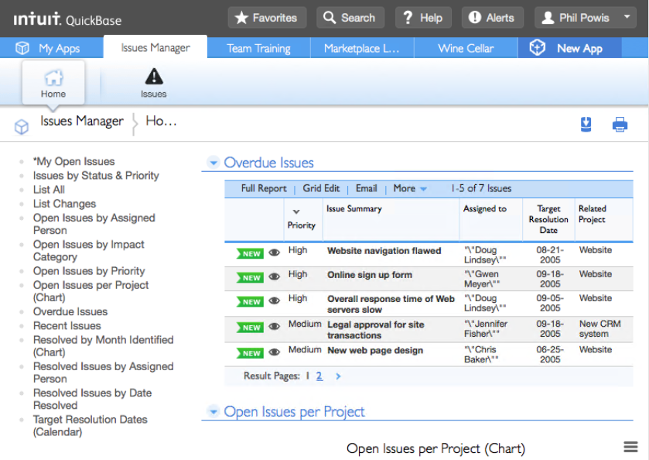
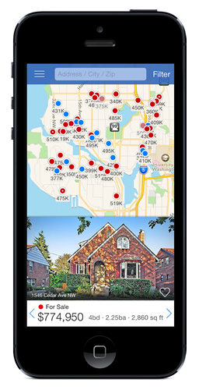
Presentation Layer
User interface concerns
Presentation of Information
Application Navigation / Menus
Data Collection / Validation
Web / Native / Mobile
Notes:
Any code responsible for user interface concerns is considered the presentation layer. In web applications the presentation layer is HTML and CSS. In mobile you build the layout using tools like Xcode or Android studio.

Slide 15
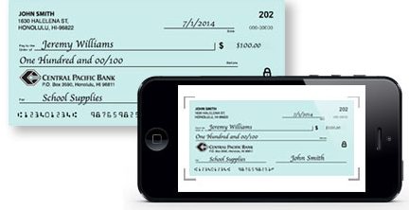
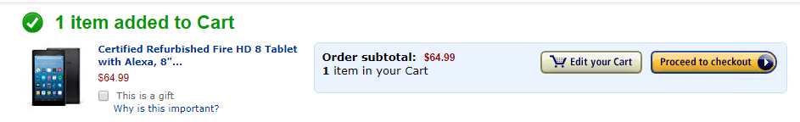
Business Logic Layer
Main transformational logic of the application; part of the application’s functionality
Written in a programming language: Java, JavaScript, Python, C#, and so on
Notes:
Business logic can be reading a credit card with your phone to get the numbers
Buying a concert ticket online with that credit card and getting an approval / receipt
Getting a text message whenever someone logs into your online bank account.

Slide 16
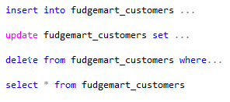
Data Logic Layer
Responsible for CRUD operations
Typically, this is code that transforms operations into the DSL (domain-specific language) to communicate with the database
Commonly SQL, but for other DBMS it could be something else.

Slide 17
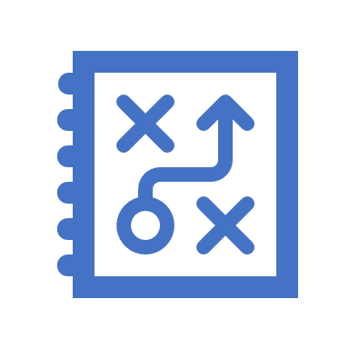
What is Data Logic ?
Data logic can be defined loosely as any logical operation that requires 1 or more reads and/or writes from a database
It makes sense to put data logic in the DBMS if it supports it.
Such operations are candidates for the data logic layer to minimize the network communication between layers
Operation: Insert or Update User
Business Logic
User 15 exists?
Update user 15
Yes
Success
Database

Slide 18
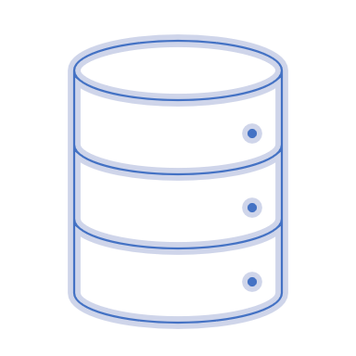
Database
Persistent Store of Data and Metadata
As required, will handle concurrency and consistency issues
Typically A DBMS, not always relational.

Slide 19
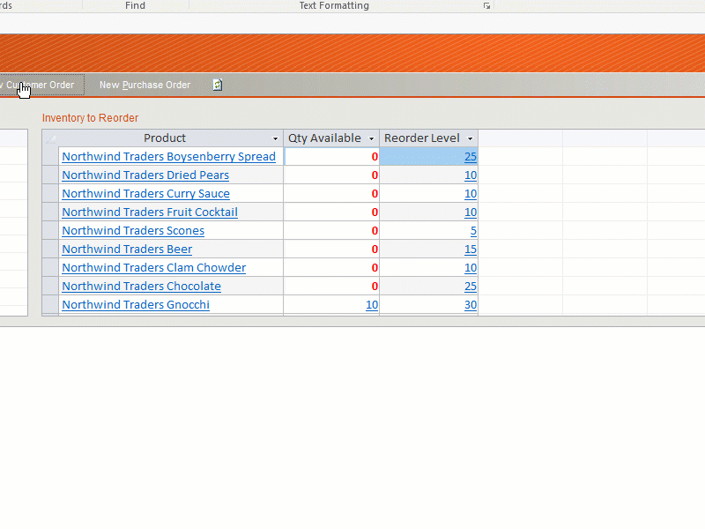
Demo:
Northwind Traders Database Application
Layers?
Presentation?
Business Logic ?
Data Logic?
Database?

Slide 20
Check Yourself: Database Application Layers
The following is an example of which layer?
A web page displays a form where you can enter your name and shipping address.
Presentation
Business Logic
Data Logic
Database
Notes:
A web page is UI thus this is the presentation layer.

Slide 21
Check Yourself: Database Application Layers
The following is an example of which layer?
When payroll is processed for any employee, their gross pay is calculated from their pay rate from the employees table and their total hours on the timecard.
Presentation
Business Logic
Data Logic
Database
Notes:
This is data logic. The needs can be met inside the database without any external logic.

Slide 22
Check Yourself: Database Application Layers
The following is an example of which layer?
When an order receives credit card information, the credit card data is sent to a payment processing gateway for approval. Upon approval the order status is changed to "paid."
Presentation
Business Logic
Data Logic
Database
Notes:
This is business logic

Slide 23
Database Applications Architectures

Slide 24

What is Application Architecture?
Defines how the workloads of a service (in this case the database application) are partitioned or subdivided over a network.
This is done so that:
More than one client (user) can access the service
The workload can be distributed to achieve better performance
Also Known As…
Multitier Architecture
Multilayered Architecture
Client-Server Architecture

Slide 25
Application Architectures
Monolithic
Monolithic over distributed storage
Two-tier thin client
Two-tier fat-client
Three Tier
N-Tier
Enterprise Service Bus
Micro Services
Complexity

Slide 26


A Monolithic Application
All layers within a single system
Simplest design
Single-user, single-site, no scale, no network
None of the clients communicate with each other or share data within the application.
Example: A To-Do application on your phone that stores the data locally
Presentation
Business Logic
Clients
Data Logic
Database

Slide 27
Monolithic Over Distributed Storage
Data storage is over a network, but the rest of the application is monolithic
Single-user, multi-site
Example: Same To-Do application that saves to cloud storage. You could open those To-Do’s on another phone if you had access to the cloud storage.
Presentation
Clients
Business Logic
Data Logic
File Storage Over Network
Data
Notes:
For example if you place a Microsoft access database in a cloud file sharing service like drop box, more than one user can access the database, but you still need the MS Access application to use the database and drop box does not handle concurrency issues for you like when more than one person updates the data at the same time.

Slide 28
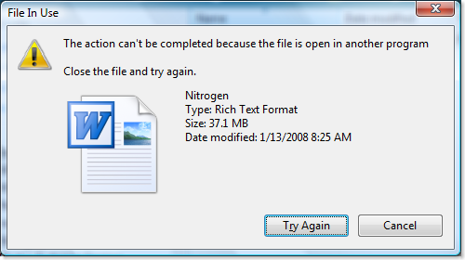
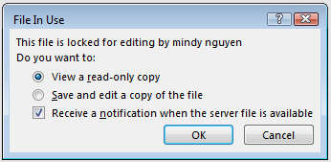
Classic Issue With Monolithic + Storage
Concurrency was not built into the application!

Slide 29
Scaling Up
To Scale an application means to redesign it so it can serve more users.
When we scale up, we either:
Add more resources more RAM, a Faster CPU to the computer running the application or
Re-design the application, splitting the layers so they can run on different computers. over a network.

Slide 30

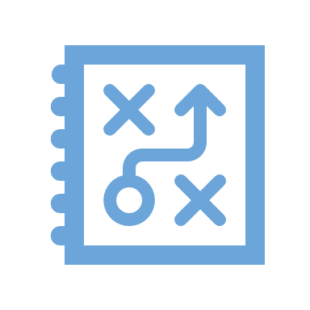

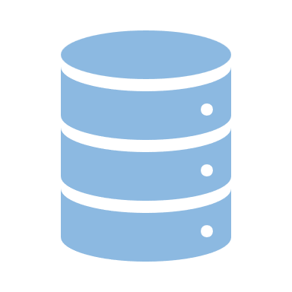
Scaling Up
We re-design / application to support multiple users by breaking up / splitting the layers.
Presentation
Clients
Presentation
Business Logic
Business Logic
Scale Up
Monolithic
Network + Middleware
Data Access
Database
Data Access
Server
Database
Notes:
We scale up data-oriented applications by separating the layers of the application into their own independent services which communicate over the network.
This allows more users to access the application, yet introduces some design complexity.
ADVANCE SLIDE
When an application’s layers are segmented we must introduce middleware between the applications of each layer in order for them to communicate. For example we might use ODBC middleware so that the data access layer can communicate with the database itself. Or in the case of the diagram you see an ODATA REST API so that the business logic can communicate with the data access layer.

Slide 31
Check Yourself: Database Application Architecture
Which of the is a reason for scaling an application?
To reach a wider target audience
To allow more users to access the application concurrently
To streamline the data logic in the application
To improve the look and feel of the presentation layer
Notes:
Scaling an application will allow it to be accessed by more users concurrently.

Slide 32
Breaking Up Is Hard To Do!
When you separate an application into parts and run them separately they now require a way to communicate with each other!
“Hey Data Logic Layer, I would like you to save this new order for me.”
Presentation
Data Logic
Clients
Middleware
Server
Business Logic
Data
“Okay, business Logic. I saved it for you. The order ID is 909242”

Slide 33
Middleware
Middleware is software that facilitates communications between the layers of an application.
It is required whenever an application is split into layers over a network.
There are different types of middleware for access between the different layers.
For communication between any two layers the layer must use the same middleware.
Notes:
Soap – simple object access protocol, ODBC -open database connectivity, ODATA -

Slide 34
Middleware Alphabet Soup
Name | What It Is/What It Does
ODBC (open database connectivity) | Database management systems access
CORBA (common object request broker architecture) | Business logic procedure call and data exchange
REST (representational state transfer) | A “pattern” that uses HTTP protocol for business logic/data exchange; foundation of most web APIs
SOAP (simple object access protocol) | Like REST but more overhead/payload
ODATA (open data protocol) | A spec for CRUD over HTTP using the REST patterns

Slide 35
Check Yourself: Database Application Architecture
What is required whenever a layer of an application is scaled up over a network?
A monolithic application
Networked file storage like google drive
A DBMS
Middleware
Notes:
Middleware or a common communications protocol between networked portions of an applications
layer is required.

Slide 36
2-Tier Client/Server
In 2 Tier client/server the application is split in two parts separated by one layer of middleware.
This makes the application multi-user and multi-Site.
Common architecture in the pre-consumer Internet era of the 90’s.
Presentation
Clients
Business Logic
Network + Middleware
Data Access
Server
Data

Slide 37
Where is the Business Logic?
“Fat Client”
“Thin Client”
Clients
Presentation
Presentation
Clients
Business Logic
Network + Telnet (example)
Data Access
Business Logic
Network + ODBC (example)
Server
Data Access
Data
Server
Data
Notes:
Thin clients might use display only middleware protocols like RDP, Telnet or SSH. The presentation layer simply draws the screen and handles input. The rest of the application runs on a single server. Thin clients are easier to maintain as the business logic (and therefore most of the code) is found in one place on the server.
Fat clients have most of the application on the client and only the database is on the server. For example you might create a window application which writes to SQL Server or MySQL using ODBC.
Thin clients do not scale as well as fat clients as most of the work is being on expensive server hardware. Fat clients are more difficult to maintain than thin clients as the application codebase is installed on every client.

Slide 38
Thin-Client, Fat-Client examples
Fat Clients:
The application itself must be installed before you can use it.
Playing a game like Madden or Fortnite
Microsoft Outlook for Email
Thin Clients:
Nothing needs to be installed for specific to the application for it to be used.
Playing a game in your Web Browser
Gmail or Yahoo Mail

Slide 39
Check Yourself: Database Application Architecture
What is the fundamental difference between a thin client and a fat client?
Choice of Middleware
Location of Business Logic
Location of Presentation Layer
Location of Database
Notes:
The location of the business logic in the client or server governs whether it is a think client or fat client.

Slide 40
3-Tier Client/Server
In 3 Tier client/server the application is split into 3 parts. Typically with a business logic and data access layer in the middle tier.
Multi-user, Multi-Site.
Scales Vertically better than 2-tier
Majority of business logic is on the server
Common architecture during the Internet boom.
Presentation
Clients
Business Logic
Network + CORBA (Ex)
Business Logic
Server
Data Access
Network + ODBC (Ex)
Data
Data
Notes:
There needs to be some business logic in the client, mainly to package up messages to be sent to the server.

Slide 41
Web 3-Tier Example (Wordpress)
Presentation
HTML/CSS
Browser
Business Logic
JavaScript
Here’s is how the popular web application WordPress is architected.
HTTP / HTTPS
Business Logic
Apache+PHP
Server
Data Access
PHP ezSQL
ODBC
Data
Database
MySQL RDBMS

Slide 42
N-Tier
Presentation
Browser
Break Up the Business Logic Even More… into as many Tiers as required.
That’s a lot of middleware. How do we deal with all that inter-process communication?
Business Logic
Web API
Business Logic
Business Logic
Services
Data Access
Data
Database

Slide 43

Enterprise Service Bus
The ESB is a software application which manages the commuinication among independent systems.
It provides a consistent messaging API and guarantees delivery of information.
It’s a more robust middleware replacement used as the message backbone for N-tier applications.
Multiple applications share messages across the same bus. This is the foundation of Service-Oriented Architecture

Slide 44
Service-Oriented Architecture
TXT Msg
Enter-
Prise
Service
Bus
Business Logic
Presentation
Website
Business Logic
CRM API
Business Logic
Presentation
Mobile App
Business Logic
Business Logic
Data Access
Application Back-End
Presentation
CRM App
Business Logic
Database

Slide 45
Check Yourself: Database Application Architecture
An Enterprise Service Bus is used in which Application Architecture?
N-Tier
3-Tier
Service-Oriented Architecture
Monolithic
Notes:
SOA

Slide 46
Web As Middleware and Microservices
The Internet ushered in major changes for application development.
The SOAP, REST, and gRPC protocols over HTTP made it easy for developers to divide up the layers of their application and split business logic into manageable microservices.
These microservices manage a single responsibility, thereby making the application easier to update and manage.
Inter-process communication uses a publish/subscribe model

Slide 47
Typical Micro Services Responsibilities
Business Capability
Customers
Orders
Inventory
Messaging
Email
Push Notification
TXT Alert
Function / Task
Transcode Video
Convert a File
Close-Caption Video
Machine Learning
Other Data
Write Log Information
Usage Statistics (Telemetry)

Slide 48
Micro Services
Presentation
Presentation
CLIENTS
Browser
Mobile App
Business Logic
Business Logic
HTTP REST
Web API
Business Logic
HTTP REST
Business Logic
Business Logic
Services
…
SERVERS
Data Access
Data Access
ODBC
ODBC
…
Data
Database
Database

Slide 49
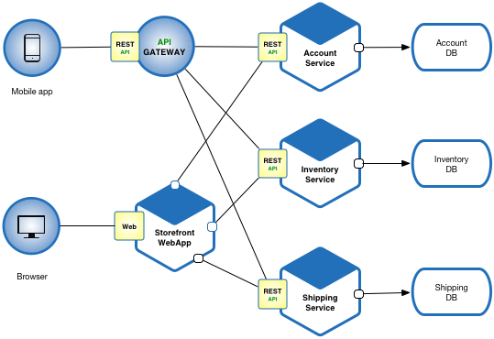
Micro Services Example
Brower and Mobile app are clients
HTTP and REST API’s are the Middleware
Separate Services for each business capability of the application
https://microservices.io/

Slide 50
Check Yourself: Database Application Architecture
Which architecture might have most of the business logic on the client?
3 Tier
2-Tier
SOA (Service-Oriented Architecture)
Microservices
Notes:
2-tier with a Fat client would have most of the business logic is on the client

Slide 51
Check Yourself: Database Application Architecture
Which architecture will commonly have more than one database?
3 Tier
2-Tier Thin Client
2-Tier Fat Client
Microservices
Notes:
Microservices architectures will commonly have more than one database

Slide 52
Tools For Building Data-Driven Apps We Will Use In This Course
Microsoft Access
Microsoft PowerApps
Architectures Supported
Monolithic / 2-Tier
Features
RAD / Low/No Code
Desktop PC Applications
Built-in Data Engine
Architectures Supported
MicroService Architecture
Features
RAD / Low/No Code
Mobile/ Web Applications
Use any Database

Slide 53
Development Of Database Applications

Slide 54
Recall: DBLC
Notes:
The database development lifecycle is a framework for building a database application. It starts with feasibility and ends with the maintenance of the completed application.

Slide 55
Model First Approach
Data Model is the driver of the Application
Conceptual Model
Logical Model
Other functional requirements are captured based on user interactions with the data model
The User Stories approach, part of Agile Modeling method help to identify
User roles
Required features
Necessary UI functionality

Slide 56

What is a user story?
A User Story is a high-level functional requirement, which focuses on the capability of a user within the system to be built.
It should contain enough information so that a programmer can implement the story trivially with reasonable effort.
There are two kinds of user stories formal and informal. Informal user stories follow no pre-determined format, whereas formal does.
Each user story should be written by a key stakeholder, or at very least with the assistance of the key stakeholders.
Notes:
https://www.agilemodeling.com/artifacts/userStory.htm

Slide 57

Informal / Formal User Stories
Informal:
Students should be able to purchase annual parking passes online.
Formal:
As a <role> I can <capability>, so that <receive benefit>
As a student I should be able to purchase a parking pass online so that drive to school.
The benefit helps to prioritize the story and rationalize its value

Slide 58
Example User Stories
Fudgemart Vacation Requests:
As an employee
I can submit a vacation request so that I can use my earned vacation time
As a manager
I can review and approve a vacation request so that my employee can take their earned vacation.

Slide 59
User Stories become Application Features
As an employee
I can submit a vacation request so that I can use my earned vacation time

Slide 60
User Stories become Application Features
As a manager
I can review and approve a vacation request so that my employee can take their earned vacation.

Slide 61
Check Yourself: Database Application Architecture
Formalize this functional requirement into a formalized user story:
“A customer places an order”
Notes:
As a customer is should be able to place an order so that I may purchase goods and services.

Slide 62
Check Yourself: Database Application Architecture
Formalize this functional requirement into a formalized user story:
“Students can pay for parking passes with Venmo”
Notes:
As a student I should be able to pay for my parking pass with venmo that I can purchase a pass without a credit card.

Slide 63
Check Yourself: Database Application Architecture
Formalize this functional requirement into a formalized user story:
“Students can view their unofficial college transcript online.”
Notes:
As a student I should be able to view my college transcript online so that I can view my official documented academic progress.

Slide 64
Summary
Database Applications are data-oriented applications and can be developed with no code /low code tools.
Database Applications are divided into layers, presentation, business logic, data logic, and database.
Database applications come in a wide variety of architectures from Monolithic to MicroServices
User Stories can be used to capture presentation and business logic concerns for Database Applications

Slide 65

Exit Ticket
What I Learned
Share one important thing you learned from this lesson!
Notes:
‘__0_’

